Slide 1
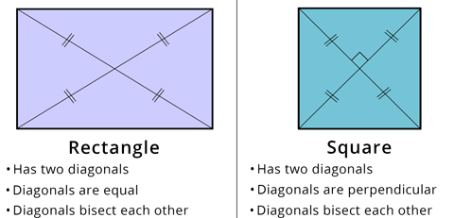
Subtopic G1.8 – Understand and use the properties of diagonals of quadrilaterals
LEARNING OUTCOME: To be able to use properties of diagonals to find angles in quadrilaterals
Objectives:
To be able to find angles involving diagonals in squares and rectangles
To be able to find angles involving diagonals in parallelograms
To be able to find angles involving diagonals in rhombuses
To be able to find angles involving diagonals in kites
To be able to find angles involving diagonals in trapeziums
Keywords:
Quadrilateral
Diagonal
Bisect
Perpendicular
Definition
Characteristics
A quadrilateral has to have four sides.
Rectangles, squares, trapeziums, kites, parallelograms and rhombuses are types of quadrilaterals.
The generic name for any four-sided shape.
Quadrilateral
Non - Examples
Examples

Slide 2
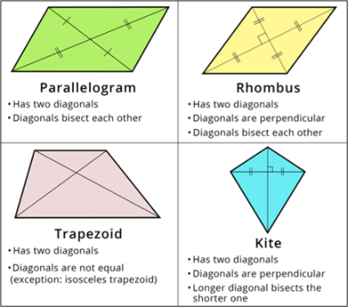









To be able to find angles in diagonals in squares and rectangles.
 | Example 1 – I do… | Example 2 – We do… | Example 3 – You do…
Steps
Look for the features of the diagonals of the quadrilateral listed above Add in the features and use them to find the missing angle.

Slide 3





















Independent Practice
a) | b) | c)
d) | e) | f)
g) | h) | i)

Slide 4































To be able to find missing angles involving diagonals in a parallelogram
 | Example 4 – I do… | Example 5 – We do… | Example 6 – You do…
Steps
Look for the features of the diagonals of the quadrilateral listed on pages 115 and 116. Add in the features and use them to find the missing angle.
Independent Practice
a) | b) | c)
d) | e) | f)

Slide 5

















To be able to find missing angles involving diagonals in a rhombus
 | Example 7 – I do… | Example 8 – We do… | Example 9 – You do…
Steps
Look for the features of the diagonals of the quadrilateral listed on pages 115 and 116. Add in the features and use them to find the missing angle.
Independent Practice
a) | b) | c)
d) | e) | f)
Notes:
EDIT QUESTIONS

Slide 6























To be able to find missing angles involving diagonals in a kite
 | Example 10 – I do… | Example 11 – We do… | Example 12 – You do…
Steps
Look for the features of the diagonals of the quadrilateral listed on pages 115 and 116. Add in the features and use them to find the missing angle.
Independent Practice
a) | b) | c)
d) | e) | f)
Notes:
EDIT QUESTIONS

Slide 7


























g) | h) | i)
j) | k) | l)
m) | n) | o)
p) | q) | r)

Slide 8
























To be able to find missing angles involving diagonals in a trapezium
 | Example 13 – I do… | Example 14 – We do… | Example 15 – You do…
Steps
Look for the features of the diagonals of the quadrilateral listed on pages 115 and 116. Add in the features and use them to find the missing angle.
Independent Practice
a) | b) | c)
d) | e) | f)

Slide 9

















To be able to find missing angles involving diagonals in an isosceles trapezium
 | Example 16 – I do… | Example 17 – We do… | Example 18 – You do…
Steps
Look for the features of the diagonals of the quadrilateral listed on pages 115 and 116. Add in the features and use them to find the missing angle.
Independent Practice
a) | b) | c)
d) | e) | f)

Slide 10


















g) | h) | i)
j) | k) | l)
m) | n) | o)

Slide 11


Question 7. The outlines of these shapes have been completely removed! Look at the diagonals and the angles given, then circle the answer to what the shapes could be.
i)
Square | Rectangle | Rhombus | Parallelogram | Trapezium | Kite
ii)
Square | Rectangle | Rhombus | Parallelogram | Trapezium | Kite
iii)
Square | Rectangle | Rhombus | Parallelogram | Trapezium | Kite
iv)
Square | Rectangle | Rhombus | Parallelogram | Trapezium | Kite

Slide 12



























Skills Check

